Slide 1
Mobile-friendly responsive websites

Slide 2
Introduction
In today's digital era, the significance of mobile-friendly responsive websites cannot be overstated. With mobile internet usage surpassing desktop usage, businesses and individuals alike must prioritize optimizing their websites for mobile devices. Not only does this enhance user experience and engagement, but it also positively impacts SEO and search rankings.

Slide 3
What is Responsive Web Design?
Responsive web design is a design approach that ensures a website adapts seamlessly to the screen size and orientation of various devices, including smartphones, tablets, and desktops. This is achieved through the use of flexible grids, layouts, and media queries, which allow the website to adjust its presentation based on the device's characteristics.

Slide 4
Benefits of Mobile-Friendly Websites
Enhanced user experience: Mobile-friendly websites offer easy navigation, readability, and interaction, leading to higher user satisfaction and longer visit durations.
Increased mobile traffic: With the proliferation of smartphones and tablets, optimizing for mobile devices allows businesses to tap into a larger audience and drive more traffic to their websites.
Improved SEO: Search engines like Google prioritize mobile-friendly websites in their search results, making them more visible to users and enhancing organic traffic.

Slide 5
Best Practices for Mobile-Friendly Design
Prioritize content and functionality: Focus on delivering essential content and functionality that is relevant to mobile users, ensuring a streamlined and efficient experience.
Optimize images and media: Compress images and use appropriate file formats to reduce loading times and improve performance on mobile devices with varying network speeds.
Implement touch-friendly navigation: Utilize large buttons, clear calls to action, and intuitive gestures to facilitate easy navigation and interaction on touchscreens.

Slide 6
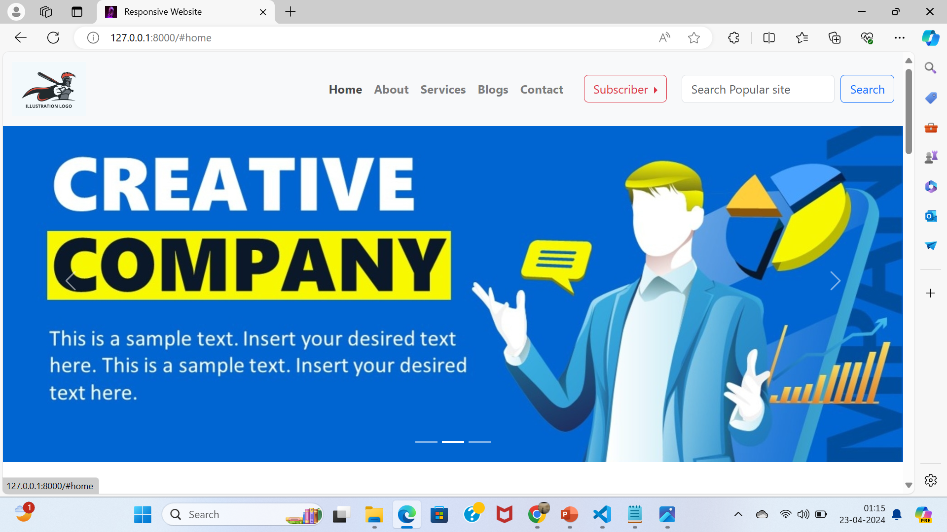

Slide 7
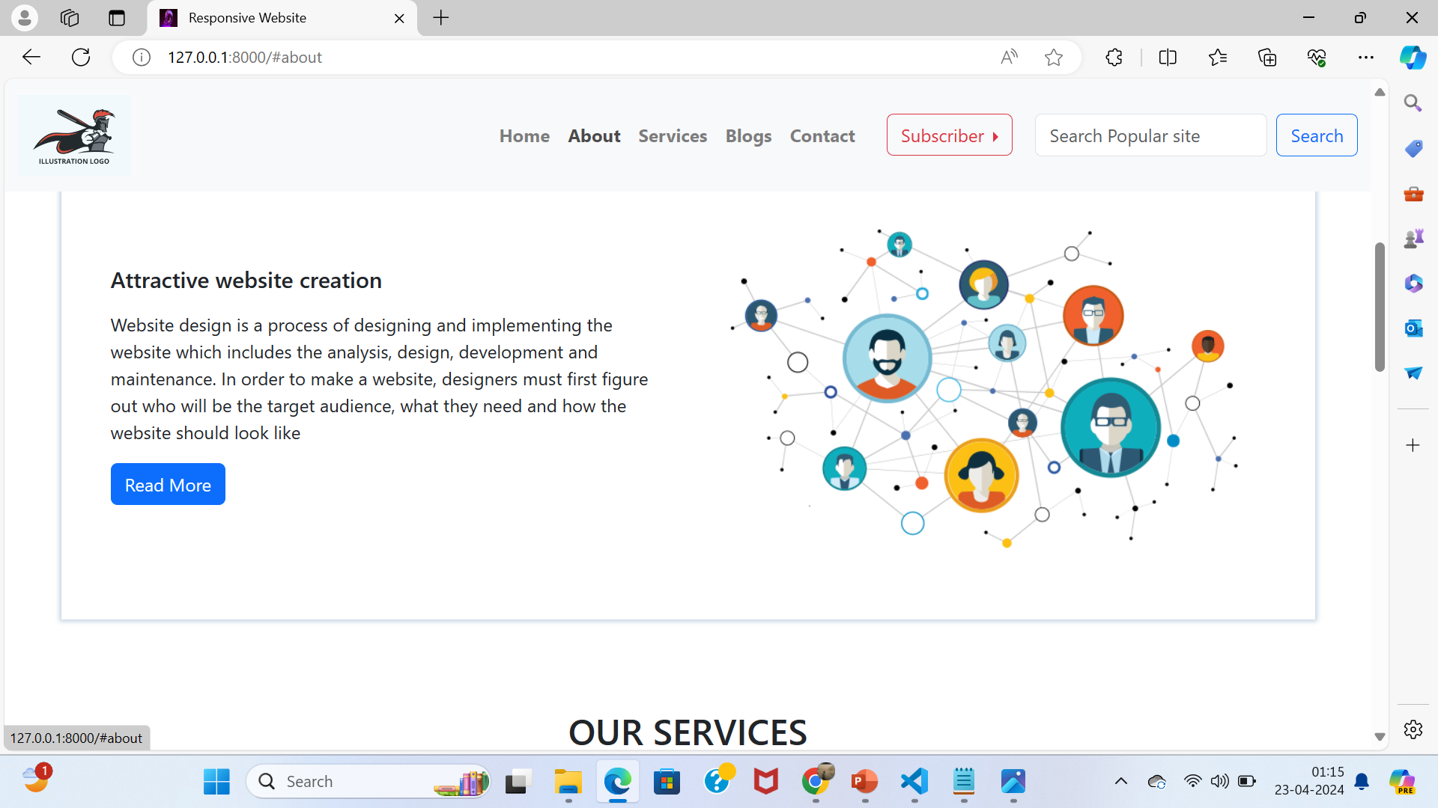

Slide 8
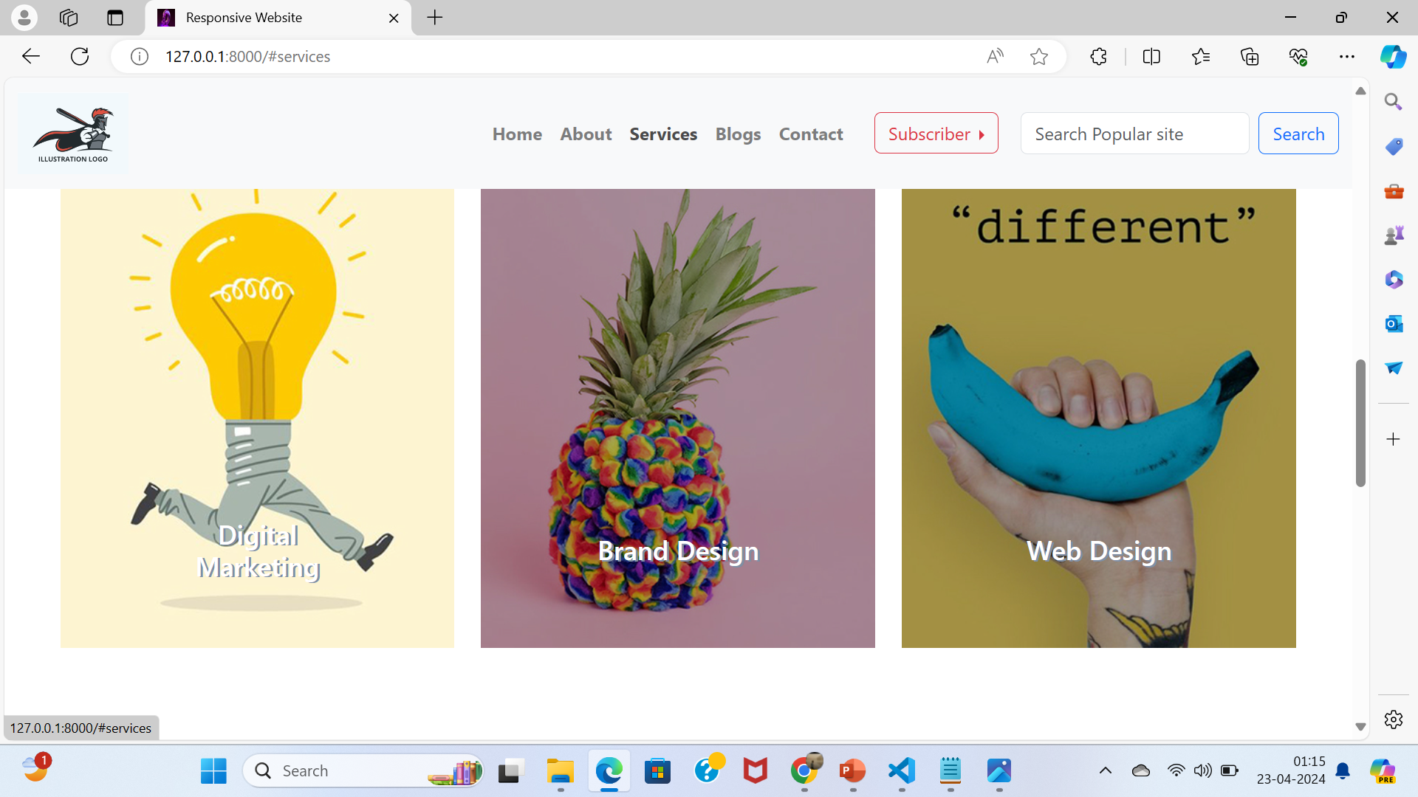

Slide 9
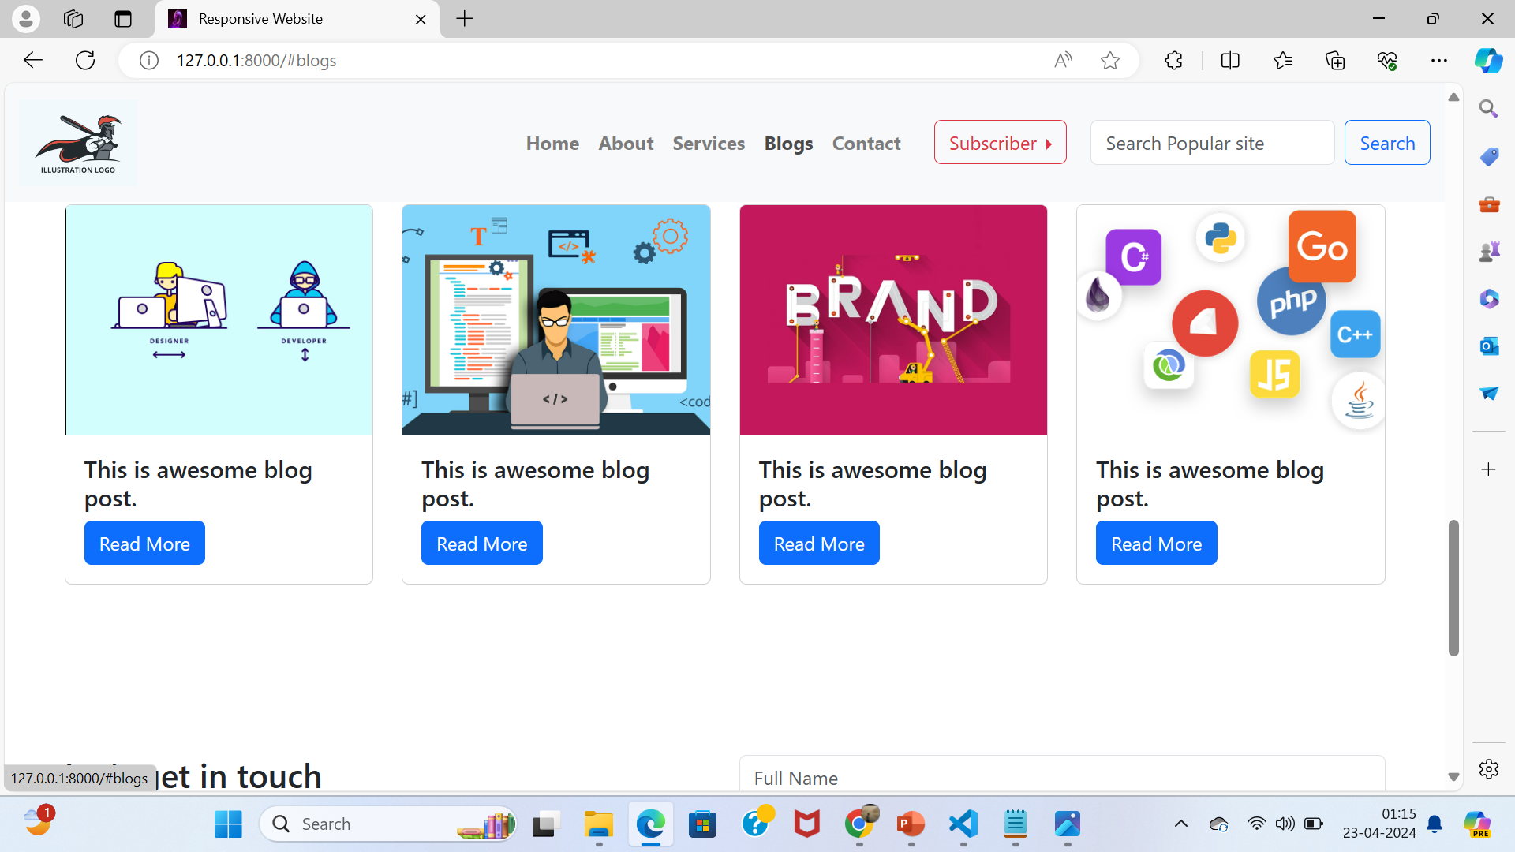

Slide 10
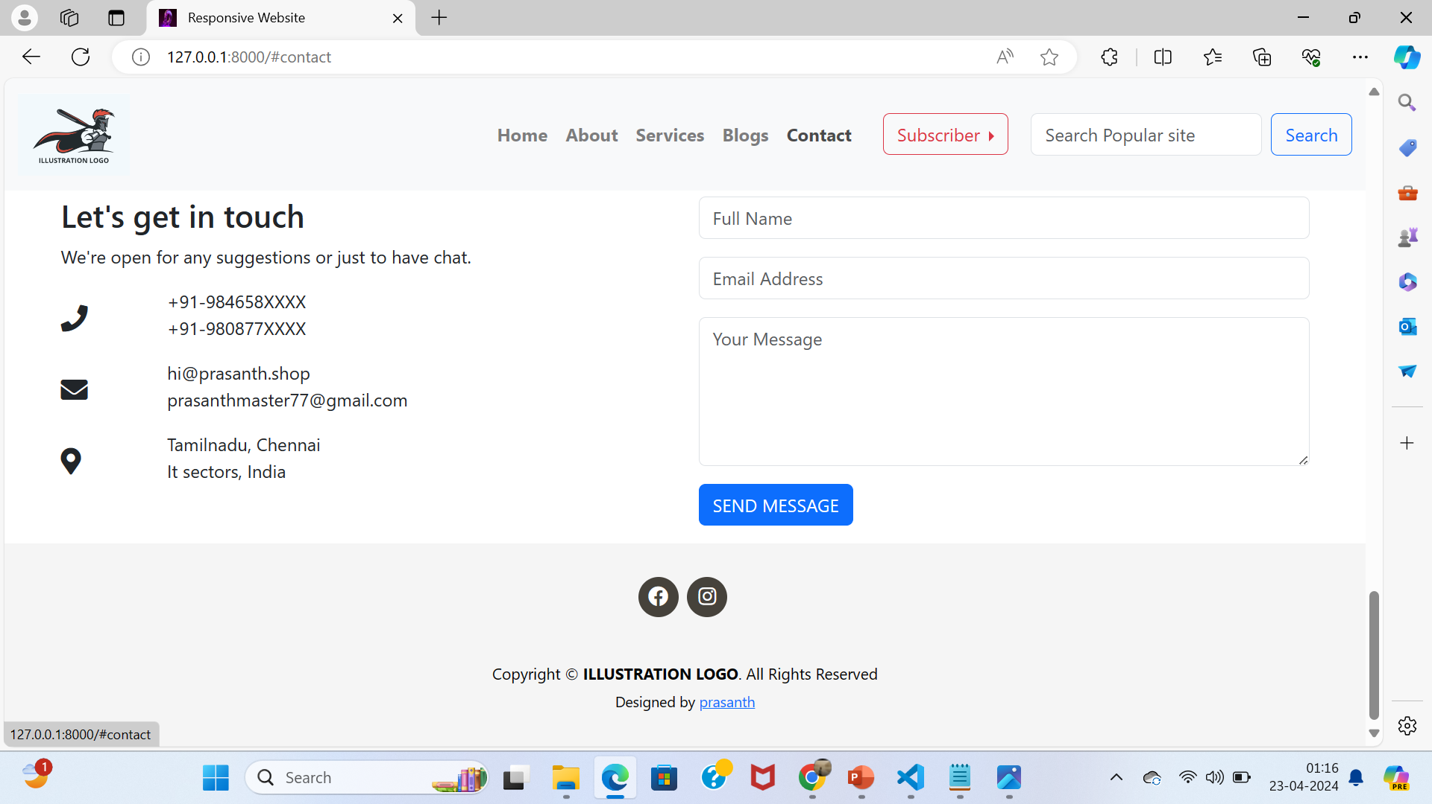

Slide 11
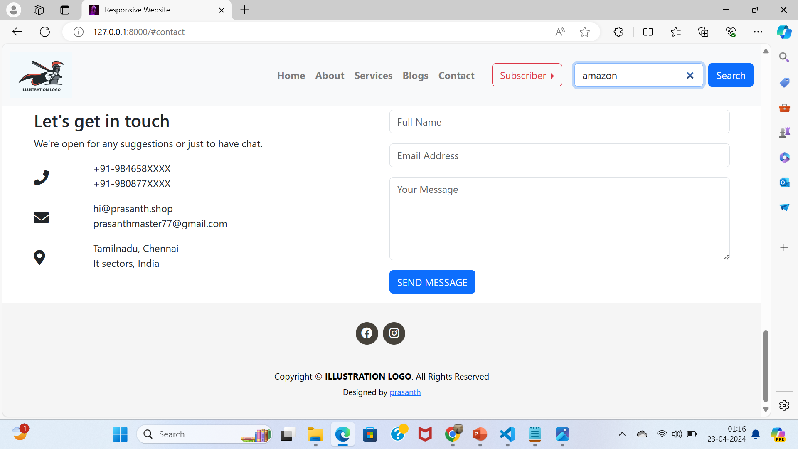


Slide 12
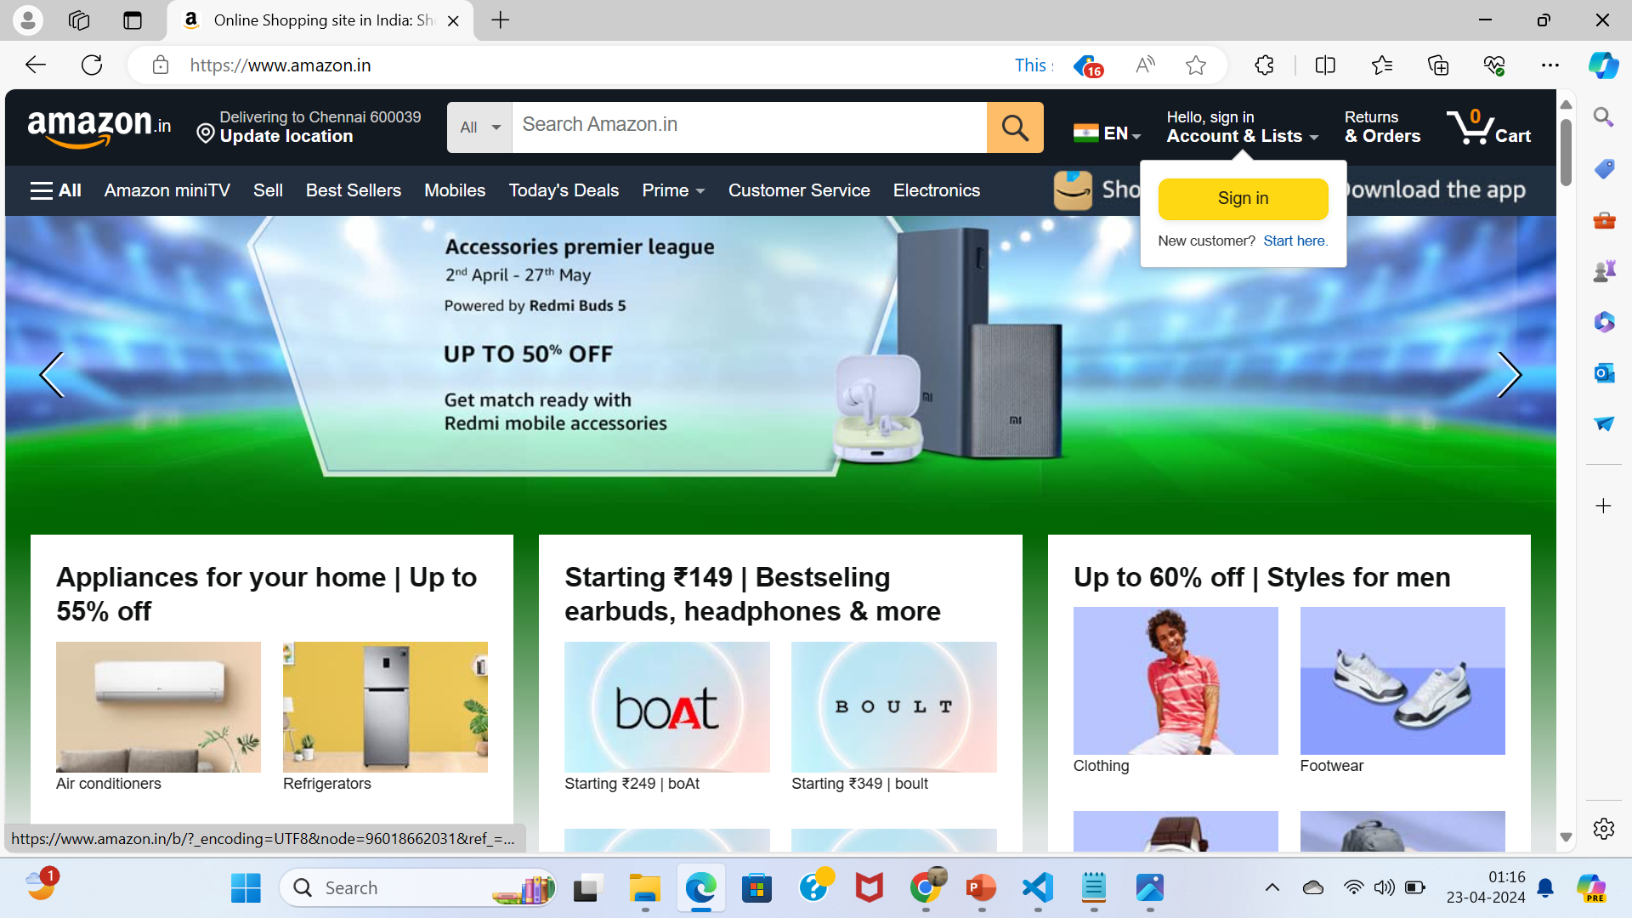

Slide 13
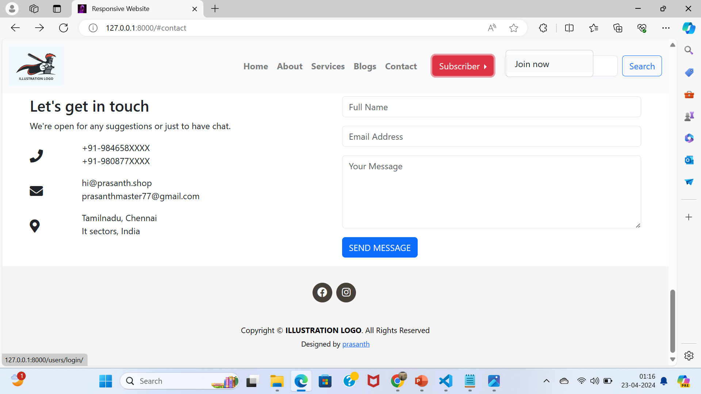


Slide 14
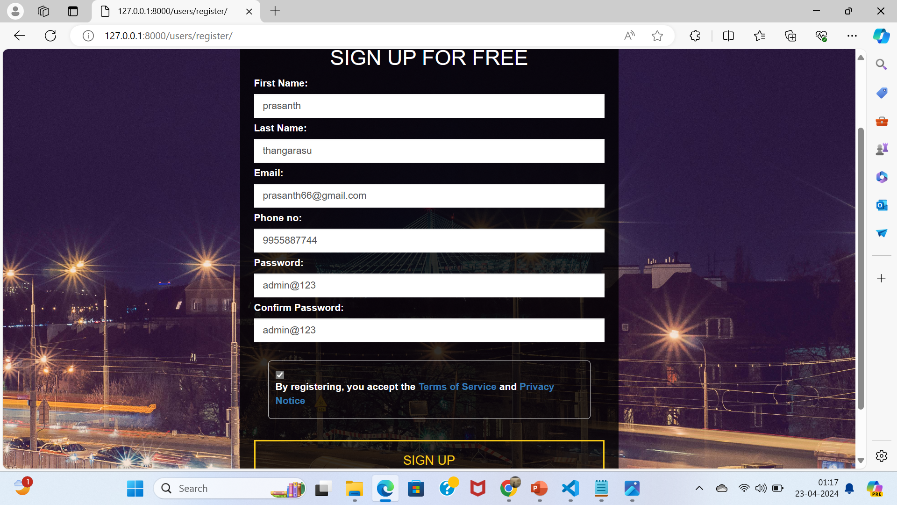

Slide 15
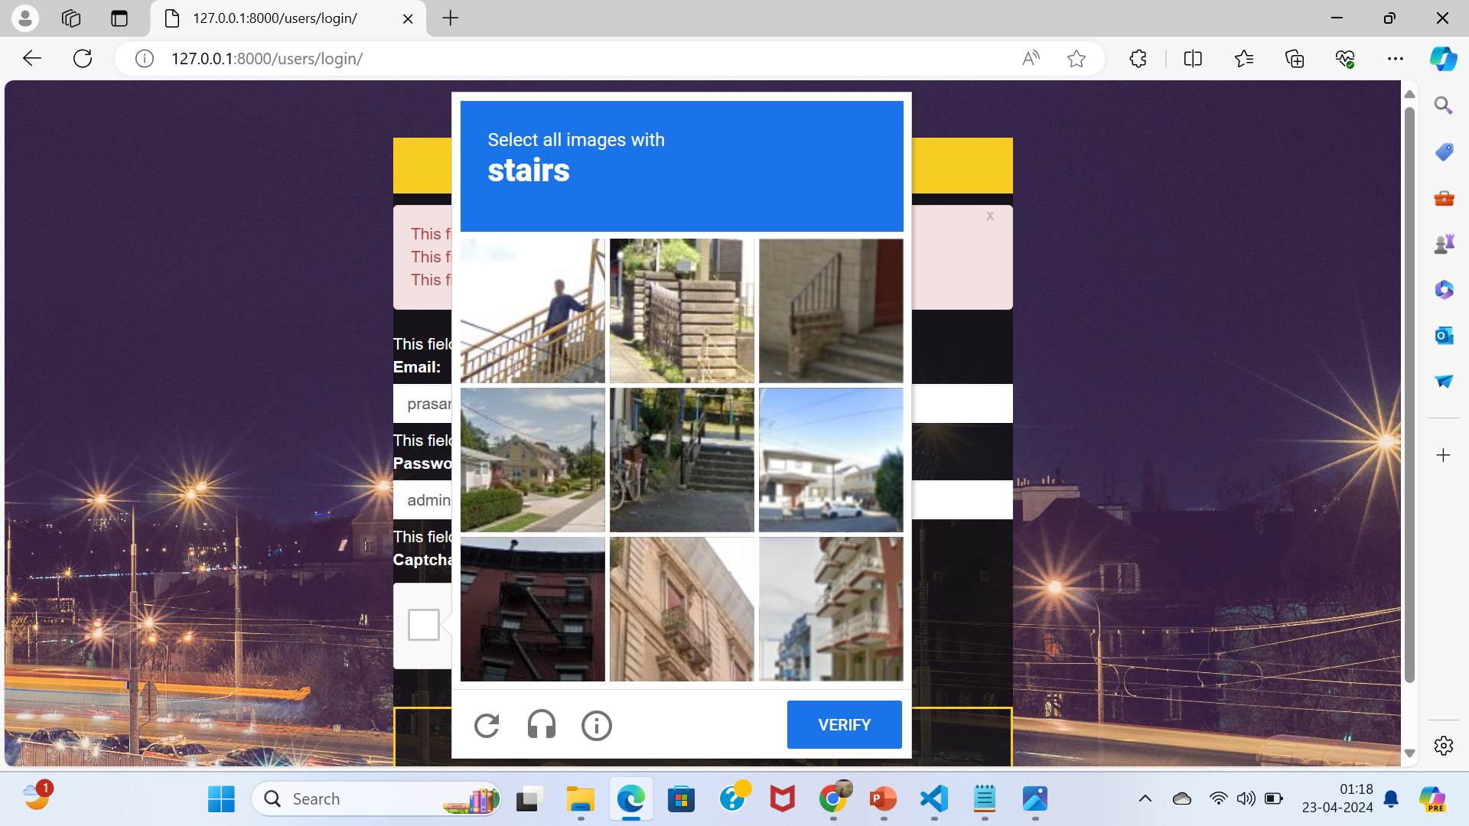

Slide 16
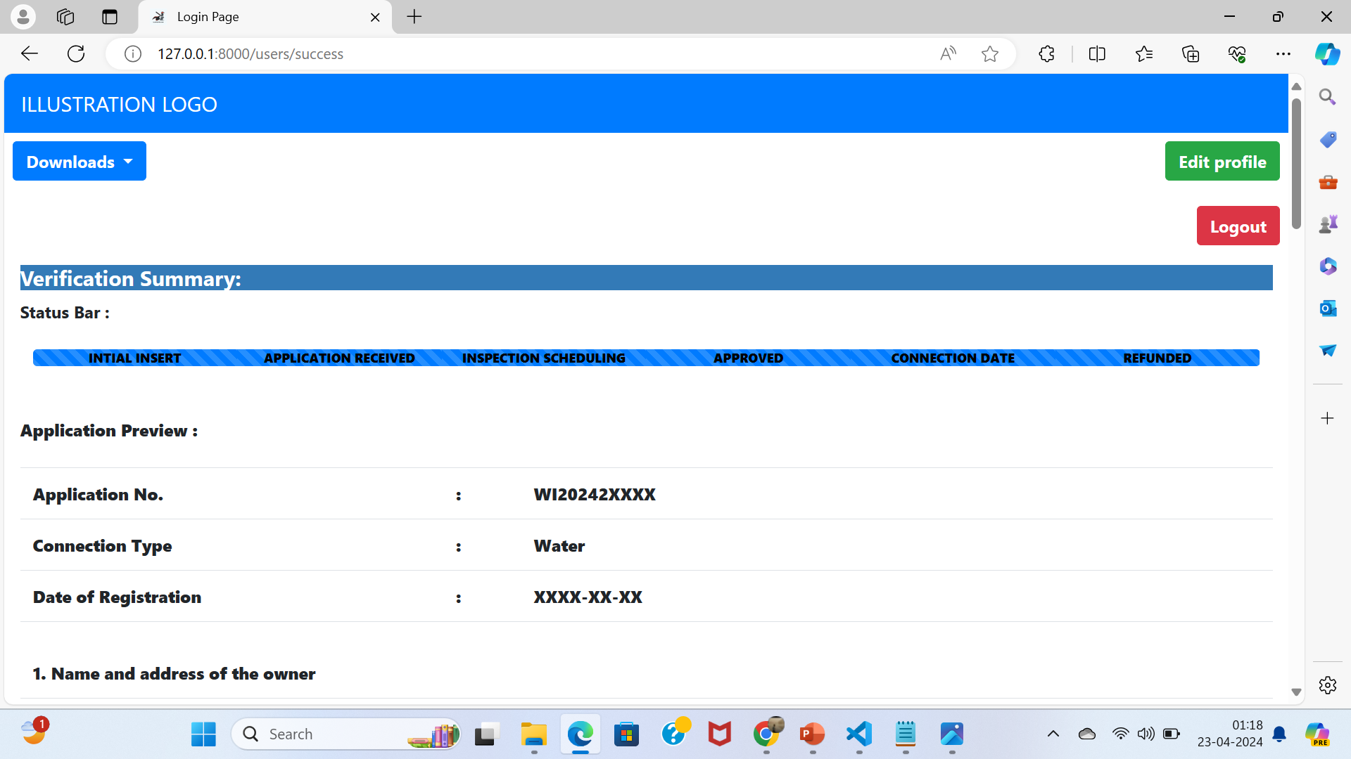

Slide 17
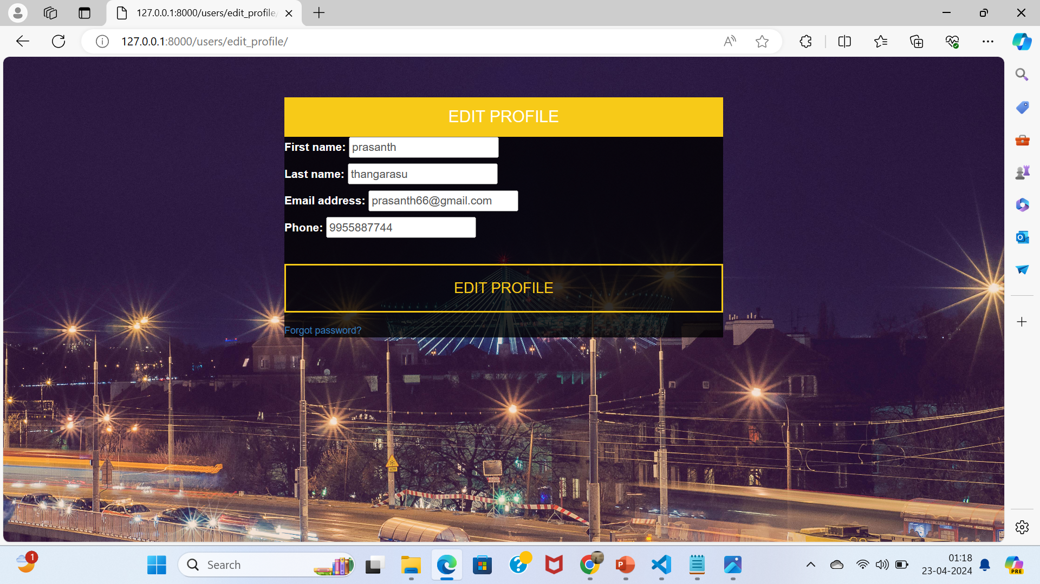

Slide 18
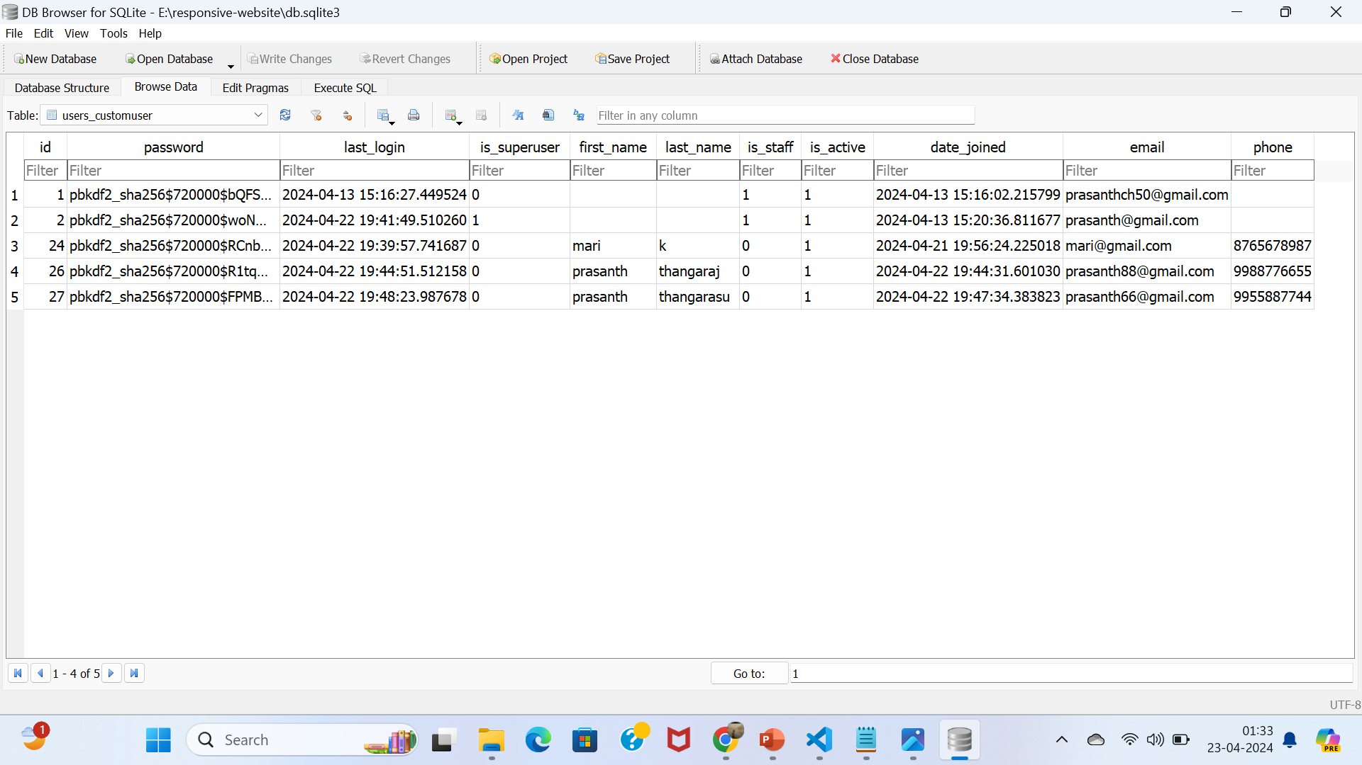

Slide 19
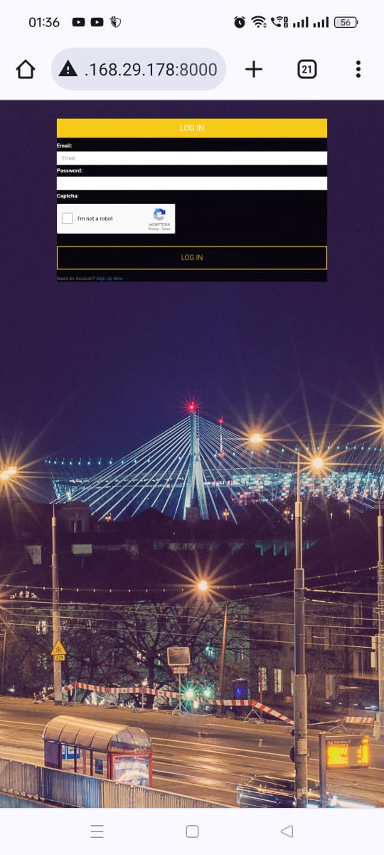
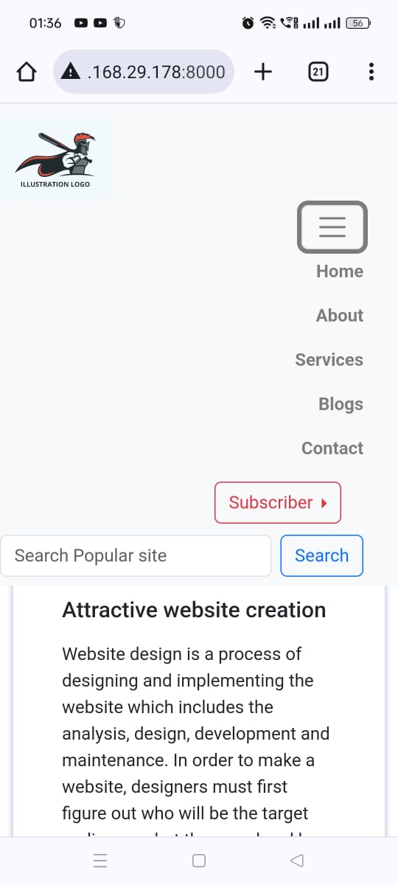
This is in mobile

Slide 20
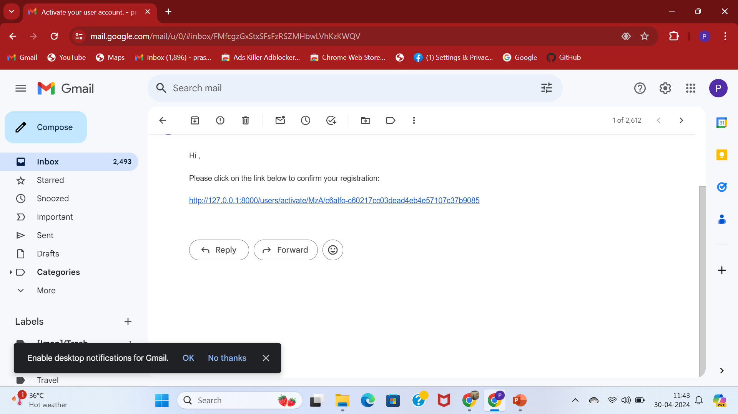


Slide 21
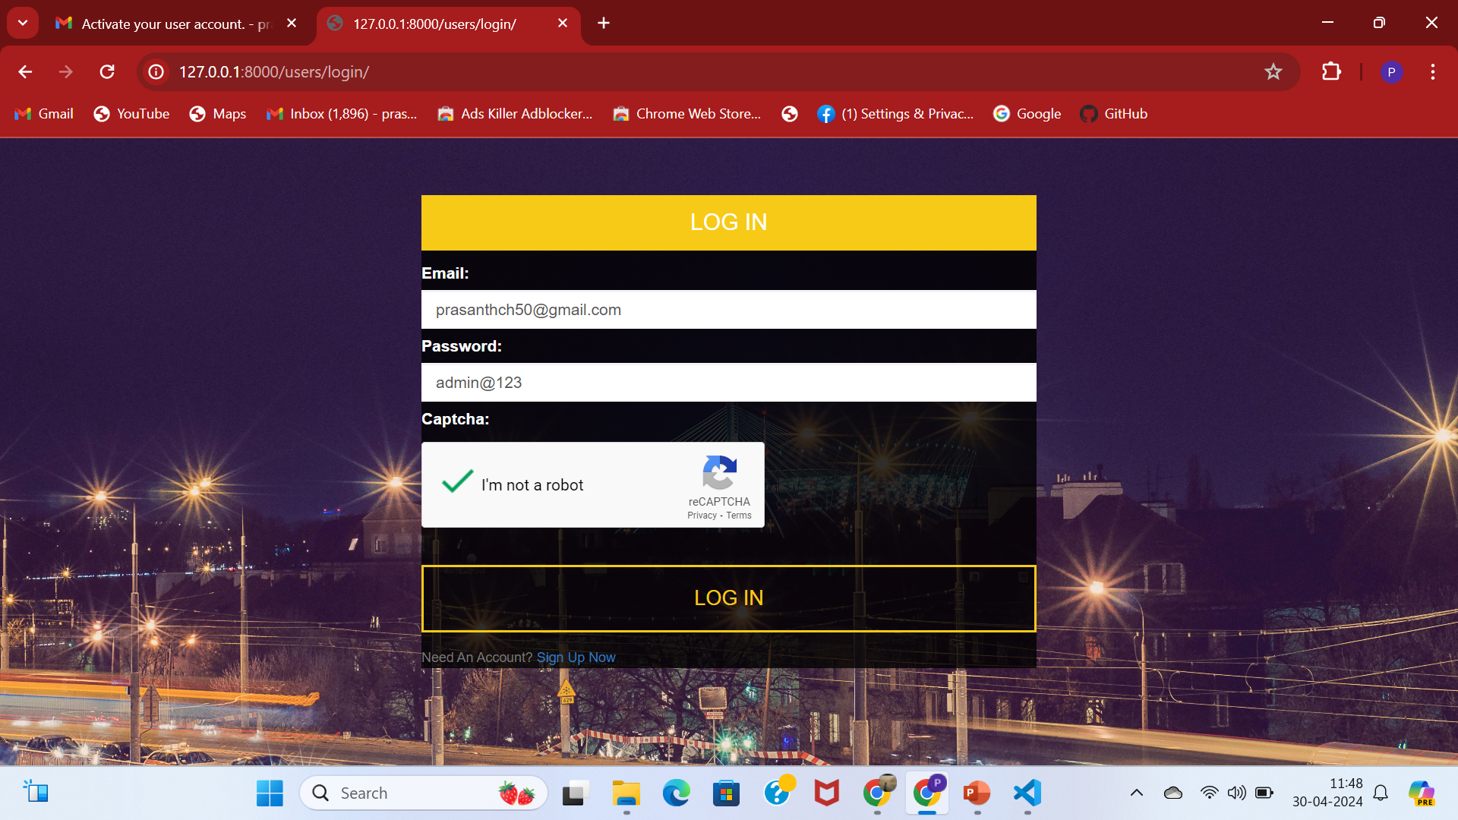

Slide 22
References
https://www.youtube.com/@PyLessons
Google and github for project reference.
I created a custom user to add more field like phone number and made email as prior for login.
Register, login every webpage created with own form field.
In this project I tried more on registration and login it took time.
Next I aimed for dynamic page with payment method than studying about forgot password before login itself.

Slide 23
Conclusion and Call to Action
Summary: In conclusion, the importance of mobile-friendly responsive websites cannot be overstated in today's digital landscape. By prioritizing mobile optimization, businesses and individuals can enhance user experience, drive more traffic, and improve their search rankings.
Call to action: Take the first step towards creating a mobile-friendly website today! Whether you're building a new site or optimizing an existing one, prioritize mobile responsiveness to stay ahead in the digital realm.

